Slide 1
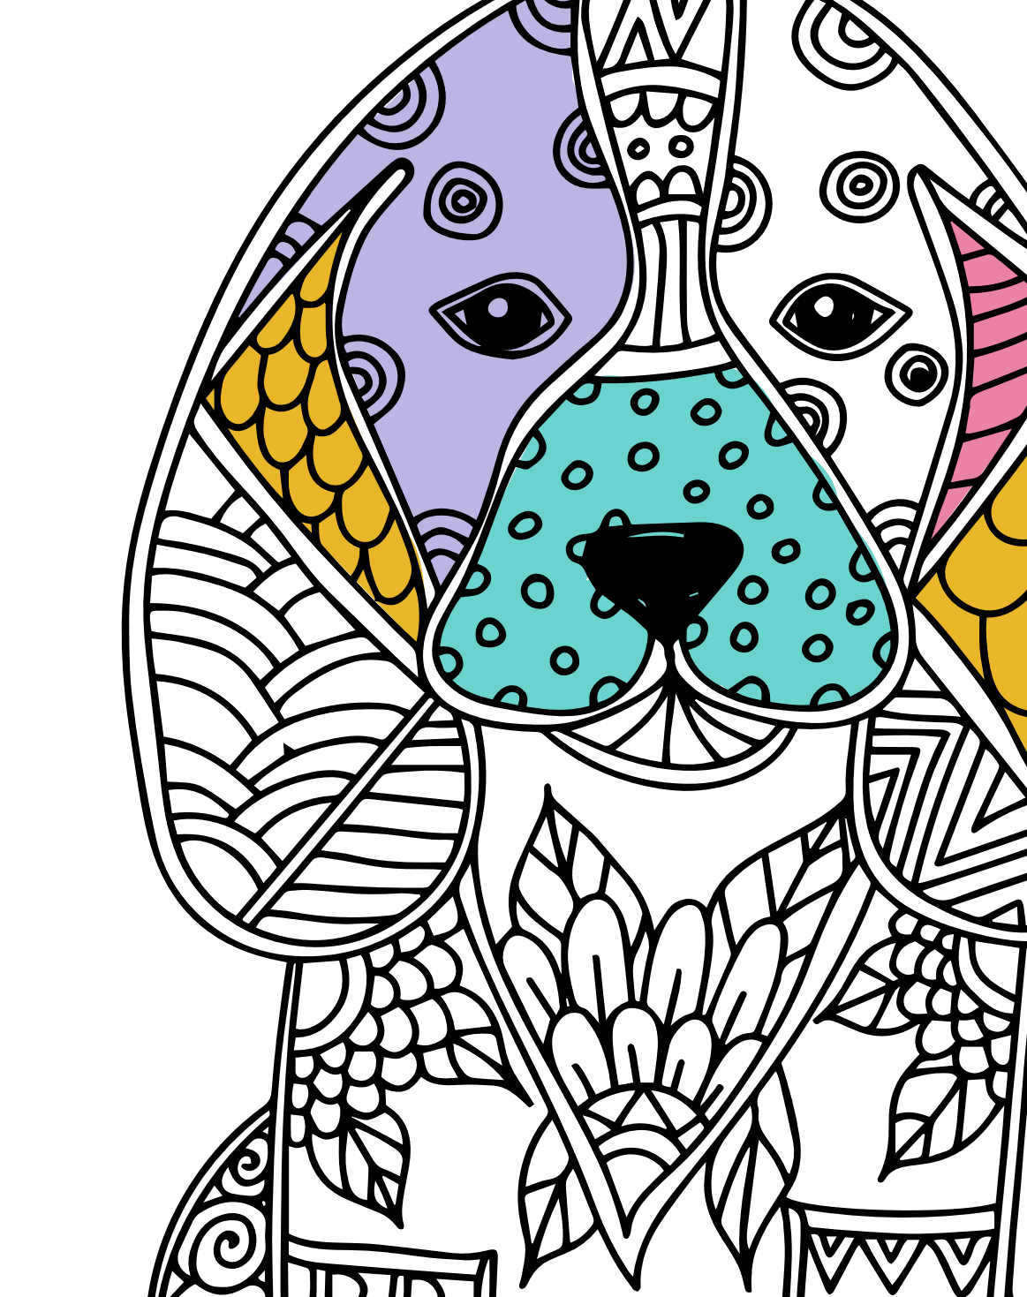
Cover page
ANIMAL DOODLE COLORING BOOK
Do you love animals? Explore wildlife through color.
Add your own color to these drawings of exotic animals and pets.
Instructions:
Print. Color. Repeat.

Slide 2

ANIMAL DOODLES DESTRESS COLORING BOOK – PICTURE 1

Slide 3

ANIMAL DOODLES DESTRESS COLORING BOOK - PICTURE 2

Slide 4
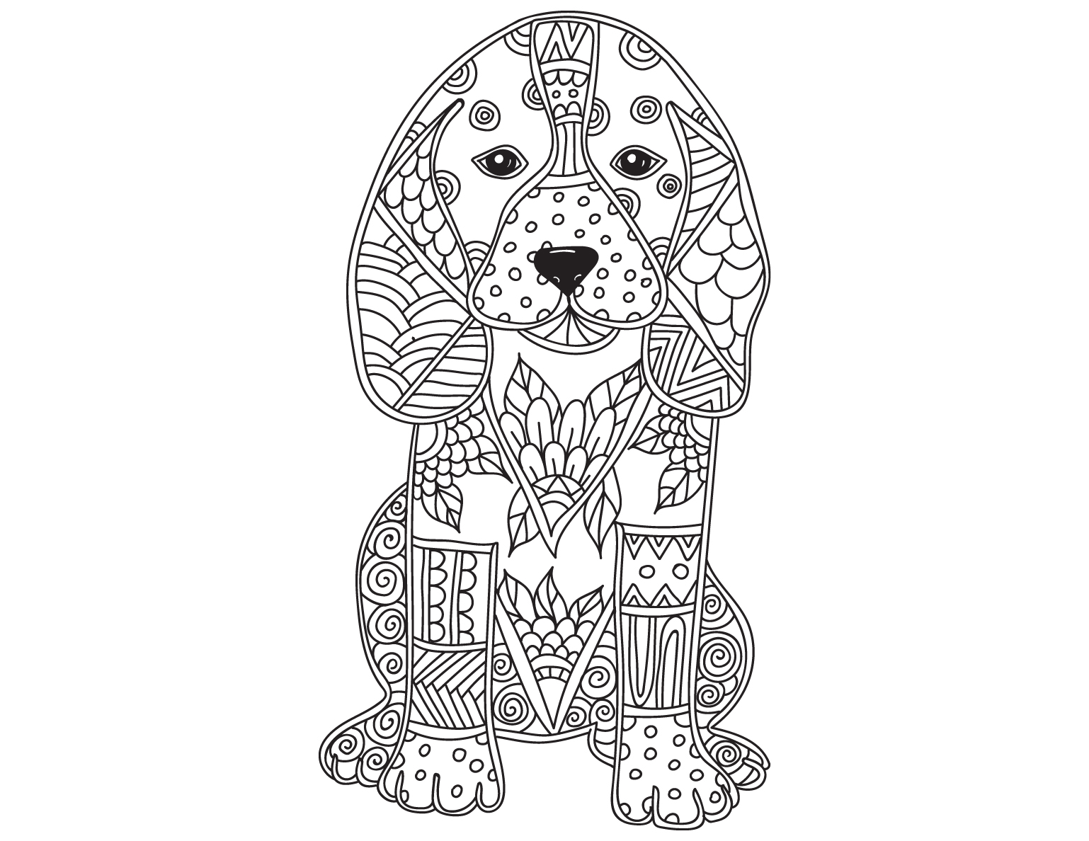
ANIMAL DOODLES DESTRESS COLORING BOOK – PICTURE 3

Slide 5
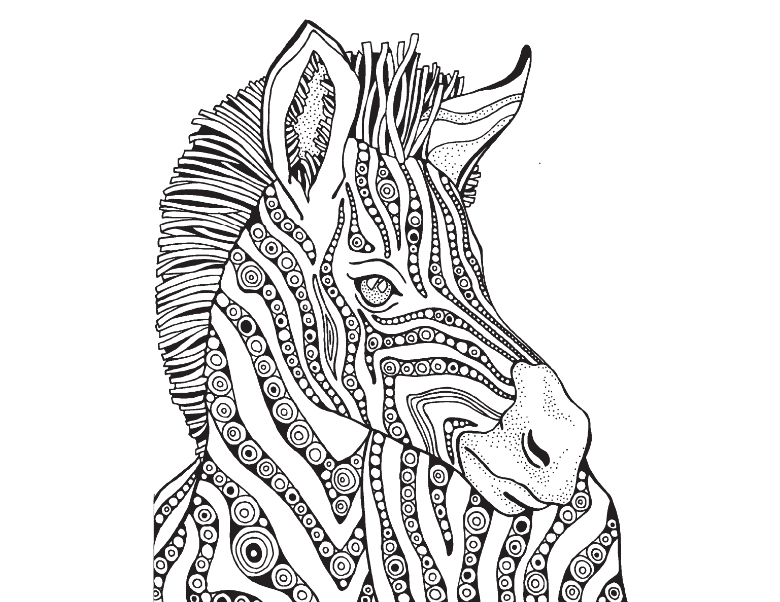
ANIMAL DOODLES DESTRESS COLORING BOOK - PICTURE 4

Slide 6
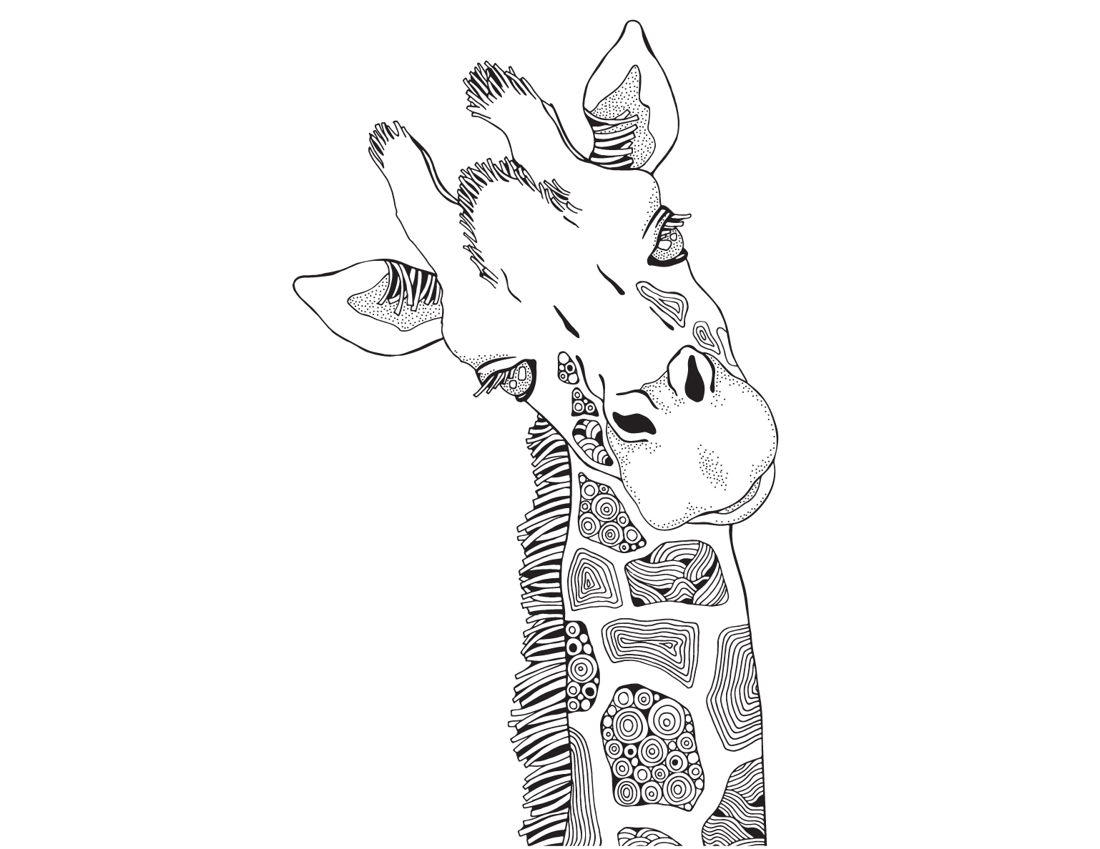
ANIMAL DOODLES DESTRESS COLORING BOOK - PICTURE 5

Slide 7
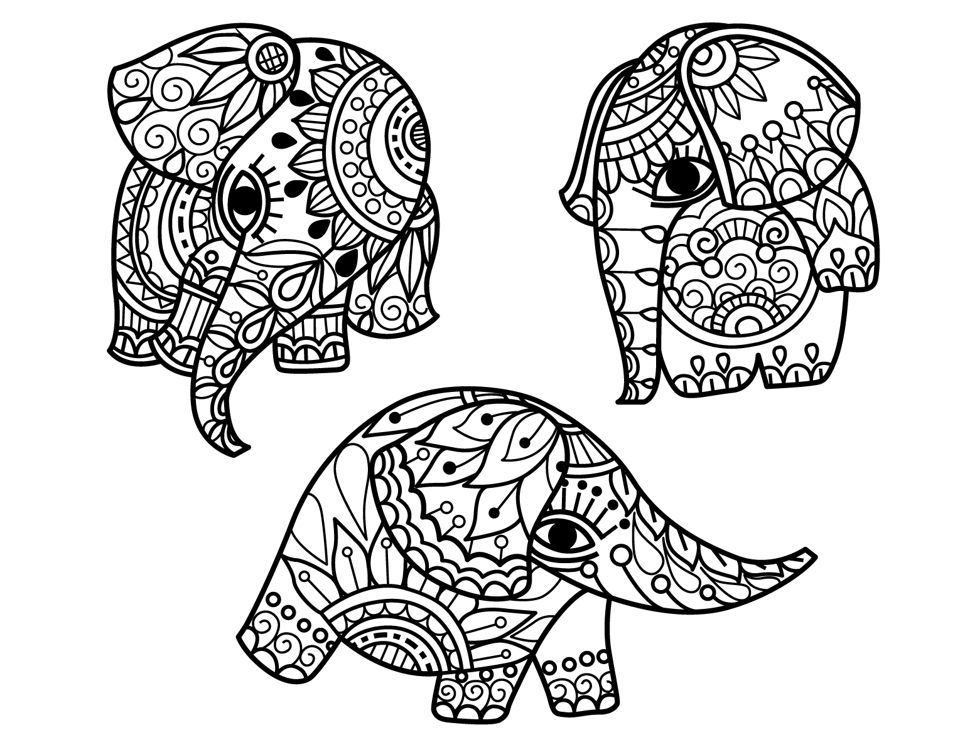
ANIMAL DOODLES DESTRESS COLORING BOOK - PICTURE 6

Slide 8
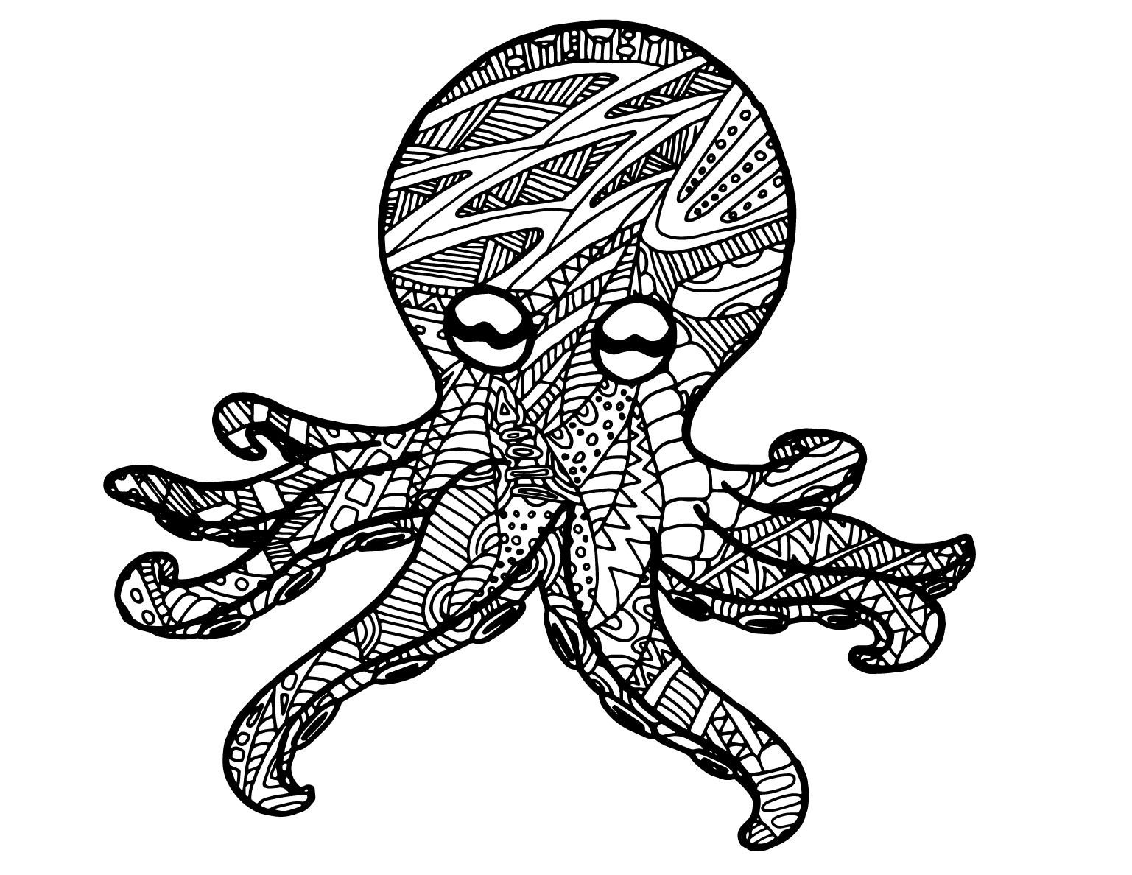
ANIMAL DOODLES DESTRESS COLORING BOOK - PICTURE 7

Slide 9
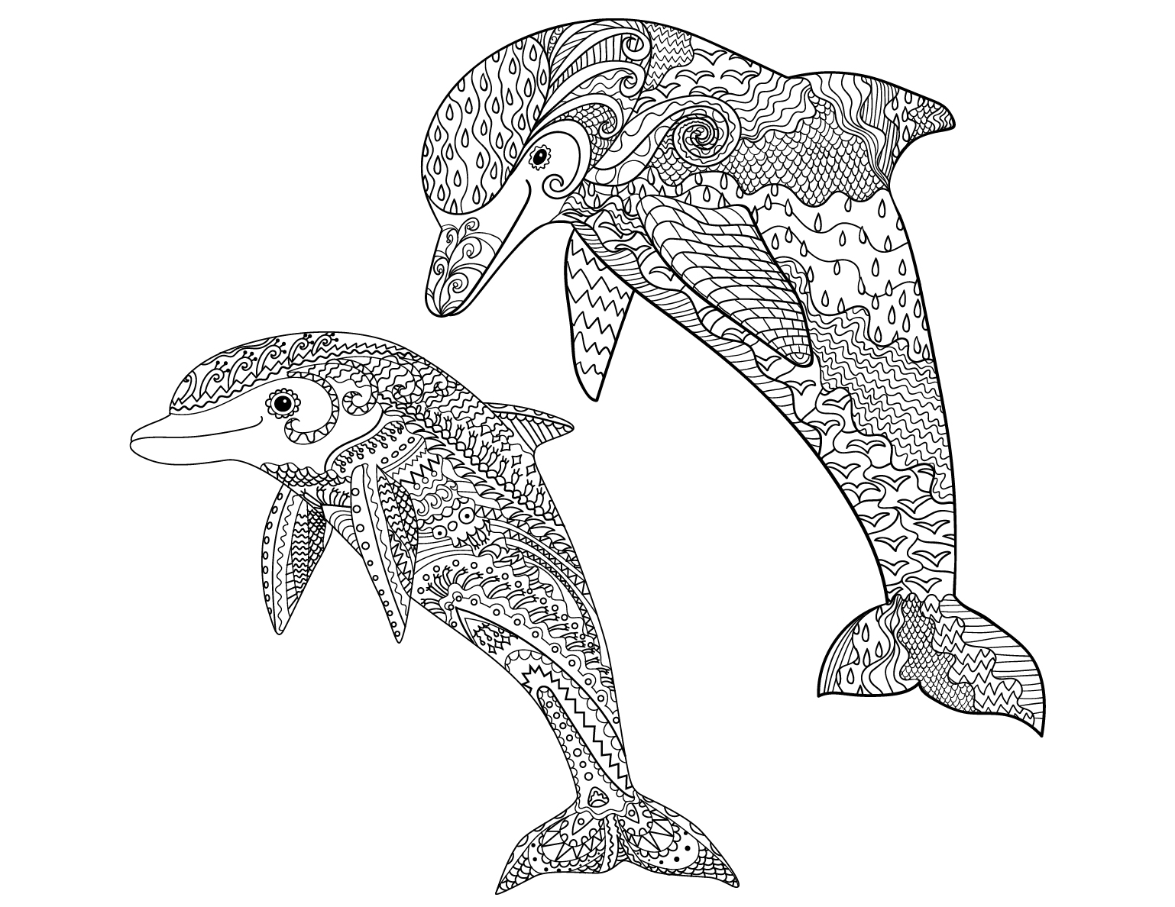
ANIMAL DOODLES DESTRESS COLORING BOOK - PICTURE 8

